Slide 1

Change & Configuration Management

Slide 2

Industry Best Practices / Guidelines
ISO/IEC 38500:2008, Corporate governance of IT
ISO/IEC 31000:2018, Risk Management
Seven Change Management Best Practices
Change Request Form Best Practices
Configuration Management Best Practices
Ansible Configuration Best Practices

Slide 3

Change and Configuration Management (Introduction)
Main Functionality
Change Request Form
Ansible Software
Innovative Feature
Connecting Change Request Form with Ansible to allow interoperability and automation of configuration process
Supporting Functionality
Detecting changes made to systems within the organization

Slide 4


Effective Communication

Slide 5


Systems Automation

Slide 6
Need for effective Change Management Process in an enterprise
Unsure how to request change
Email flooding everywhere
Chaotic and ineffective
Don’t know what changes are/were made at what time
No logs of changes recorded
Web applications are vulnerable to many attacks (less secure)

Slide 7
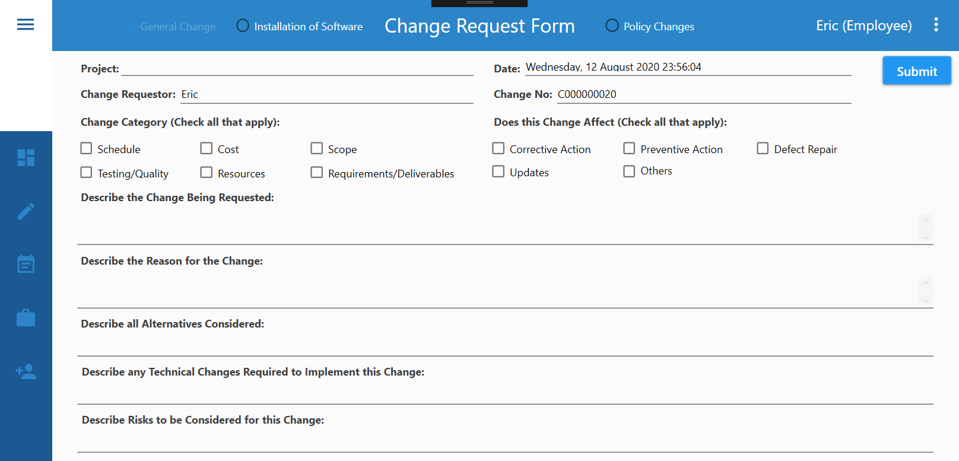

Slide 8





IT Representative
BE Representative
Change Request Form
2) Approves
3) Review
Senior Management
Change Request Form
Change Request Form
Effective Change Management Process
Better Governance of Enterprise IT
Business aligned to IT
Effective communication
1) Submits
General Employee

Slide 9
Play Video
IT Representative
BE Representative
Change Request Form
2) Approves
3) Review
Senior Management
Change Request Form
Change Request Form
Relevant standards and frameworks:
ISO/IEC 38500:2008, Corporate Governance of Information Technology Standard, 2008
1) Submits
General Employee

Slide 10
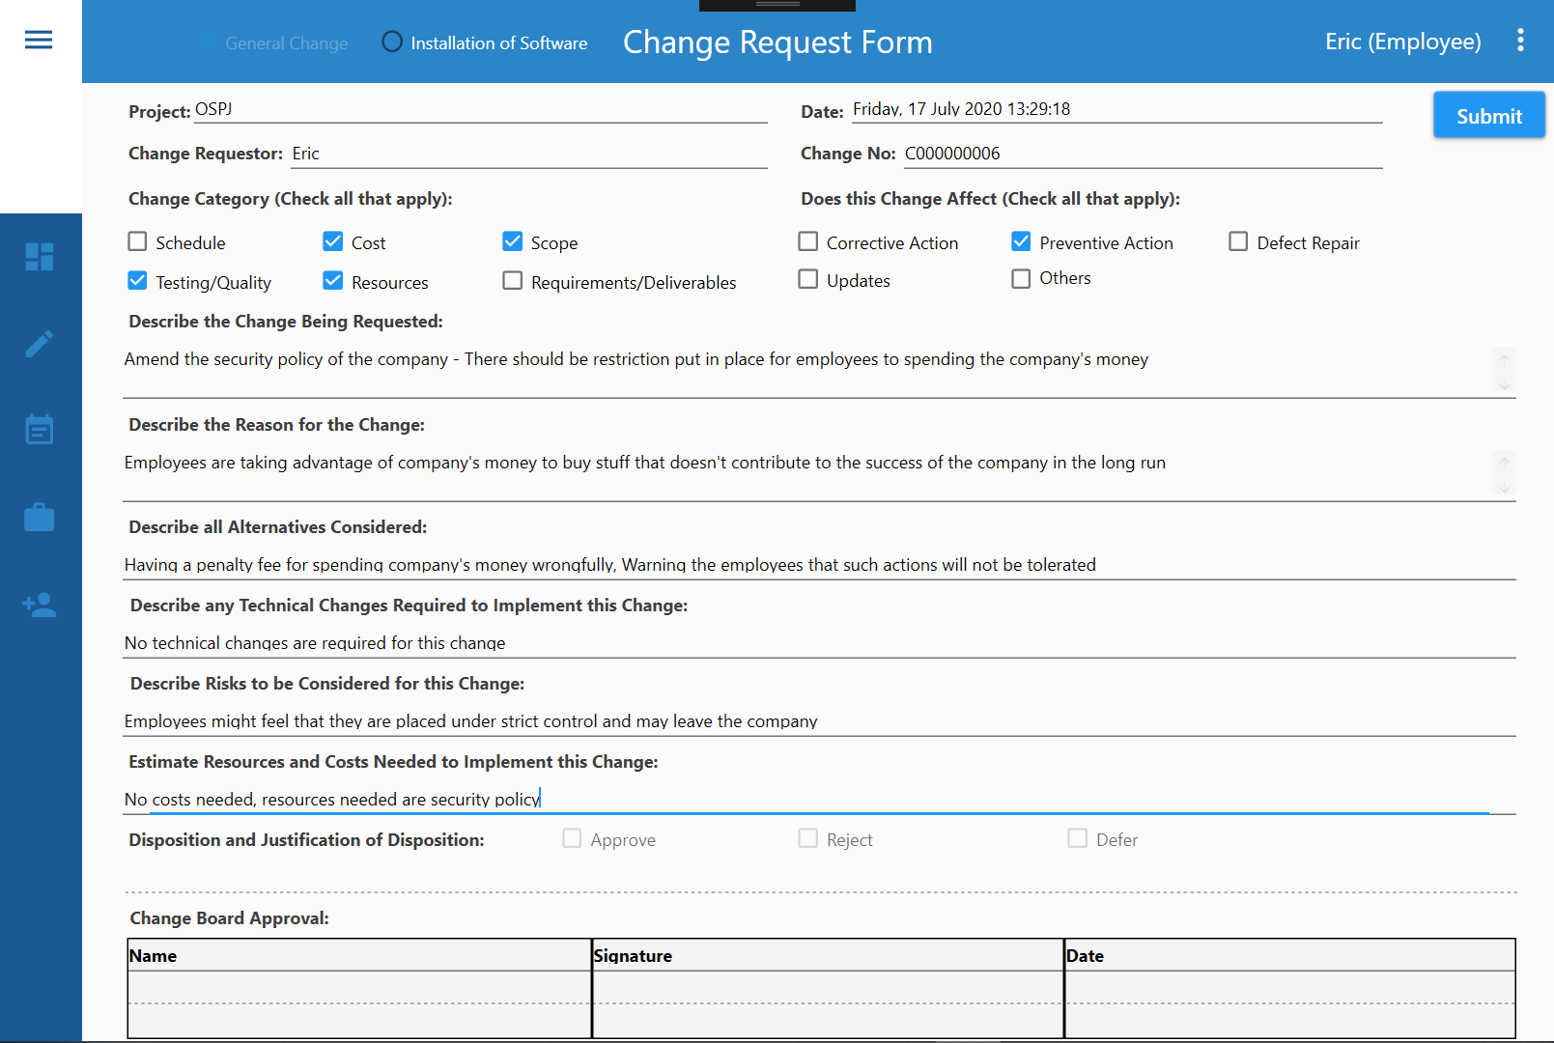

Slide 11
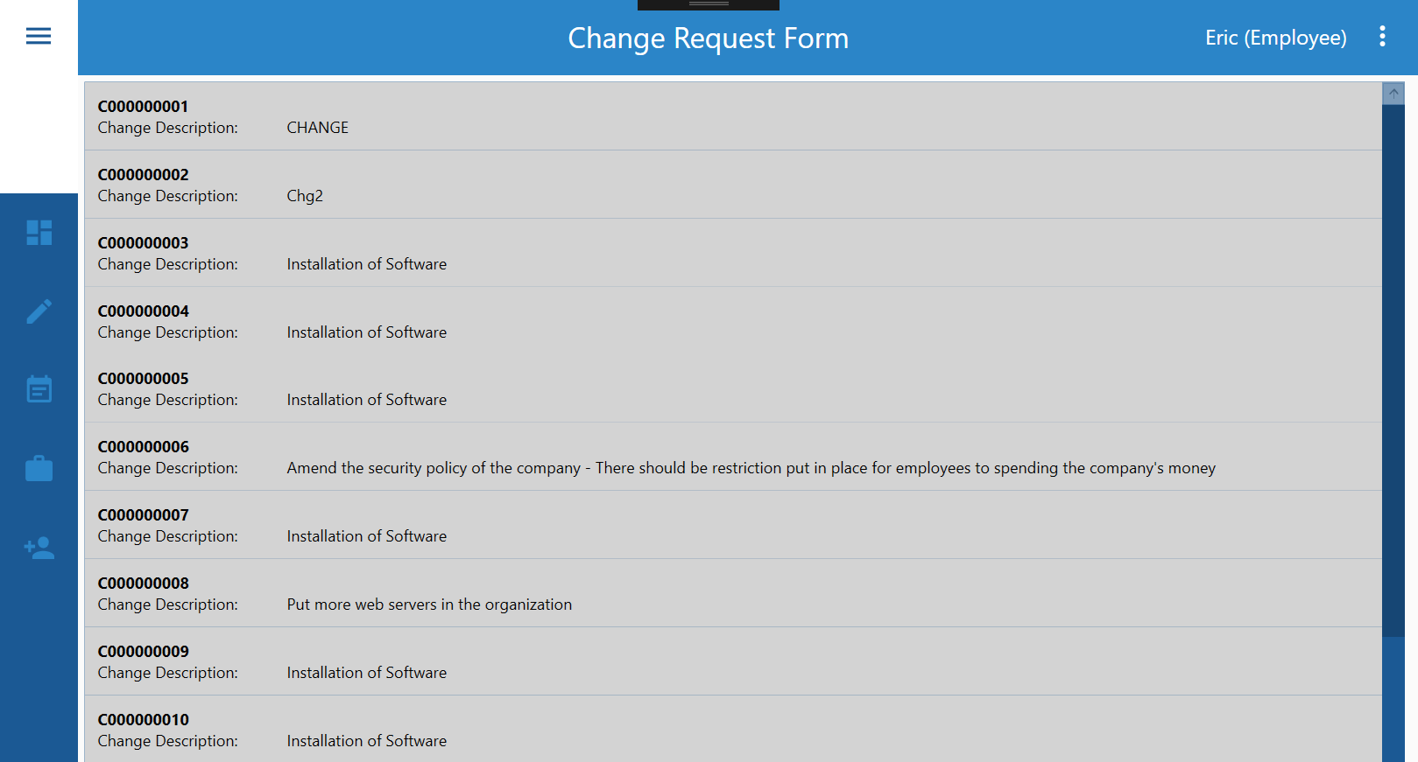

Slide 12



Server 1
Ansible Control Machine
(Push Configuration)
…
Server 2
Configures multiple servers
Server n

Slide 13

Advance features displaying innovative technologies
Ensuring Automation & Interoperability
Connecting “Change Request Form” with “Ansible” Software

Slide 14
Change Mgt
Config Mgt
Server 1
IT Representative
BE Representative
…
2) Approves
Server 2
3) Review
Senior Management
Change Request Form
Change Request Form
Configures multiple servers
1) Submits
Server n
General Employee

Slide 15
Change & Config Mgt
Server 1
IT Representative
BE Representative
2) Approves
…
3) Review
Senior Management
Server 2
Change Request Form
Change Request Form
If requires installation of software, notify C&C Server
Installs software into servers
1) Submits
If requires installation of software, notify C&C Server
Server n
General Employee
C&C Server

Slide 16
Play Video
Test Case (3): Employee requests change through General Change Request Form
Test Case (4): Employee requests installation of software through Software Request Form
Test Case (5): (Continued from Test Case #4) Automate software installation
Test Case (6): (Alternate Flow of Test Case #5) Install already installed software into target server(s)
Test Case (7): Employee requests policy changes through Policy Request Form
Test Case (8): (Continued From Test Case #7) Automate policy changes
Test Case (9): Employee requests system updates through Policy Request Form
Test Case (10): (Continued from Test Case #9) Automate system updates
Test Case (11): Employee requests configuration changes (e.g. disabling domain firewall) through Policy Request Form
Test Case (12): (Continued from Test Case #11) Automate configuration changes
Test Case (13): Simultaneously install web server/service and deploy required web pages into 8 new Linux Servers

Slide 17
Play Video
Test Case (3): Employee requests change through General Change Request Form
Test Case (4): Employee requests installation of software through Software Request Form
Test Case (5): (Continued from Test Case #4) Automate software installation
Test Case (6): (Alternate Flow of Test Case #5) Install already installed software into target server(s)
Test Case (7): Employee requests policy changes through Policy Request Form
Test Case (8): (Continued From Test Case #7) Automate policy changes
Test Case (9): Employee requests system updates through Policy Request Form
Test Case (10): (Continued from Test Case #9) Automate system updates
Test Case (11): Employee requests configuration changes (e.g. disabling domain firewall) through Policy Request Form
Test Case (12): (Continued from Test Case #11) Automate configuration changes
Test Case (13): Simultaneously install web server/service and deploy required web pages into 8 new Linux Servers

Slide 18
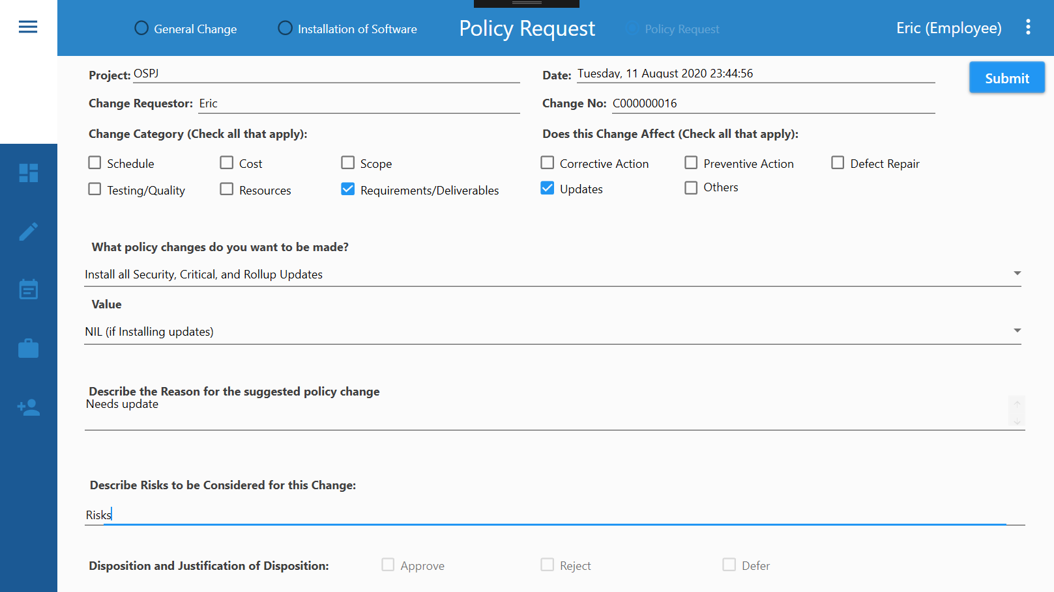
Test Case (9): Employee requests system updates through Policy Request Form

Slide 19
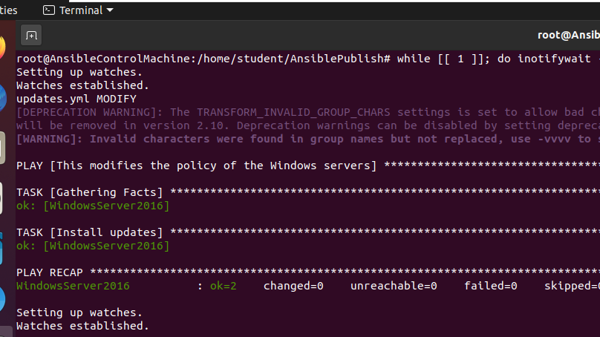
Test Case (10): (Continued from Test Case #9) Automate system updates

Slide 20

Test Case (11): Employee requests configuration changes (e.g. disabling domain firewall) through Policy Request Form

Slide 21
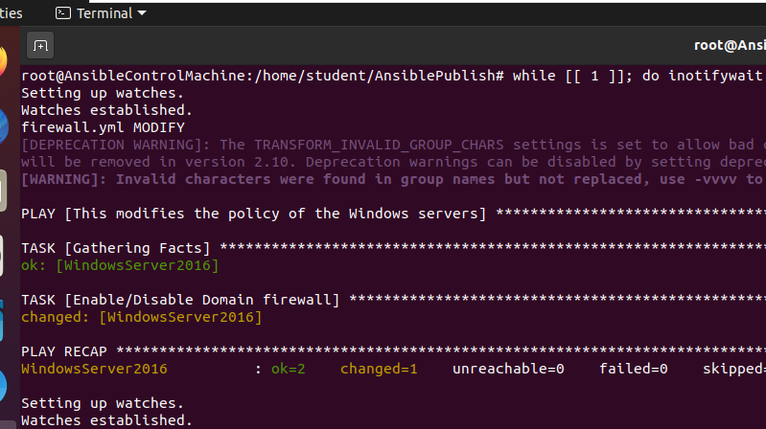
Test Case (12): (Continued from Test Case #11) Automate configuration changes

Slide 22
Play Video
Test Case (3): Employee requests change through General Change Request Form
Test Case (4): Employee requests installation of software through Software Request Form
Test Case (5): (Continued from Test Case #4) Automate software installation
Test Case (6): (Alternate Flow of Test Case #5) Install already installed software into target server(s)
Test Case (7): Employee requests policy changes through Policy Request Form
Test Case (8): (Continued From Test Case #7) Automate policy changes
Test Case (9): Employee requests system updates through Policy Request Form
Test Case (10): (Continued from Test Case #9) Automate system updates
Test Case (11): Employee requests configuration changes (e.g. disabling domain firewall) through Policy Request Form
Test Case (12): (Continued from Test Case #11) Automate configuration changes
Test Case (13): Simultaneously install web server/service and deploy required web pages into 8 new Linux Servers

Slide 23
Server 1
Ansible Control Machine
(Push Configuration)
…
Server 2
Configures multiple servers
Server n

Slide 24
Benefits
Effective Change Management Process
Better Governance of Enterprise IT
Business aligned to IT
Effective communication
Save manpower, cost, time and efforts
Automation of configuration management process
Centralized change request logs
Changes can be tracked easily
New employees can appreciate the current situation in the organization
Less susceptible to attack
Change Request Form application only requires port 1433 to be open (and doesn’t require port 80)
Less port exposed = Less vulnerability = Lower chance of exploitation

Slide 25
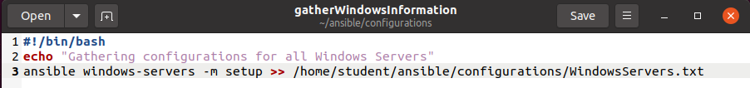
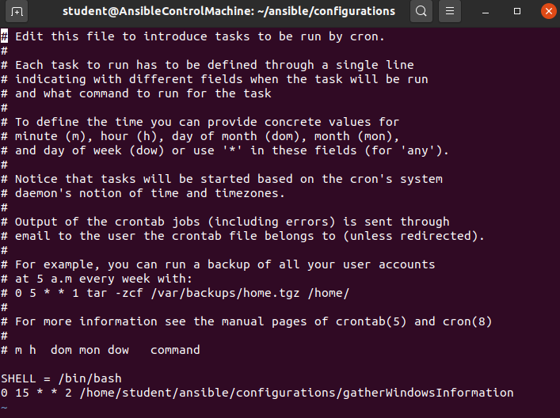
Automating gathering of inventory using “cron”

Slide 26
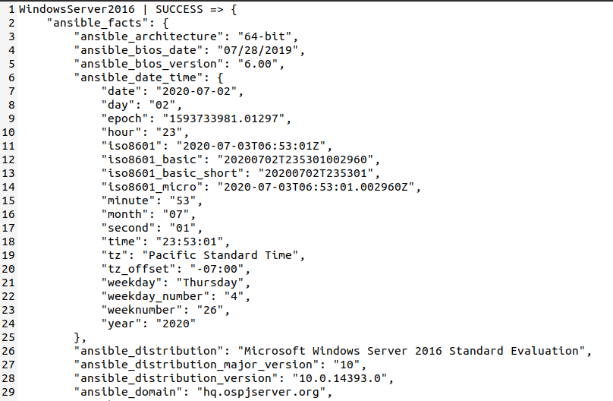
Sample of Inventory File

Slide 27
Test Scenario 3
Vulnerability Assessment and Penetration Testing
Hardening the application that is being used to support the Change & Configuration Management Process.

Slide 28
Test Case #14 & #15
Test Case (14): A person (penetration tester/unauthorized hacker) exploits misconfigurations in target application
Test Case (15): Review of configuration management best practices (Already presented in the above slides)

Slide 29
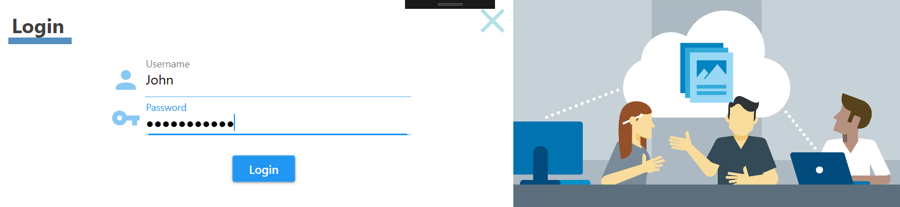
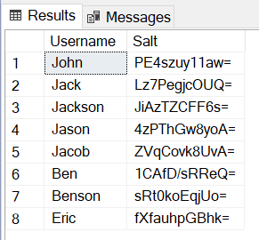
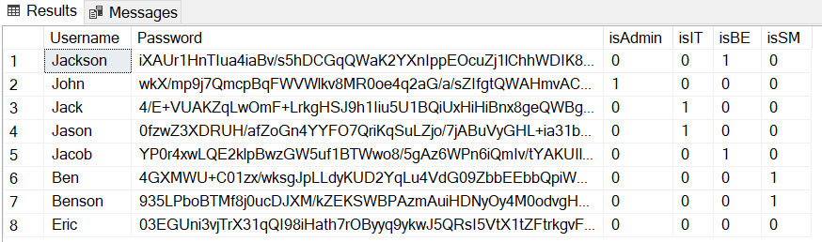
Test Case (14): A person (penetration tester/unauthorized hacker) exploits misconfigurations in target application
SQL Injection
Stored credentials (encrypted)
Dictionary/Rainbow Table Attack

Slide 30

Supporting Functionality

Slide 31
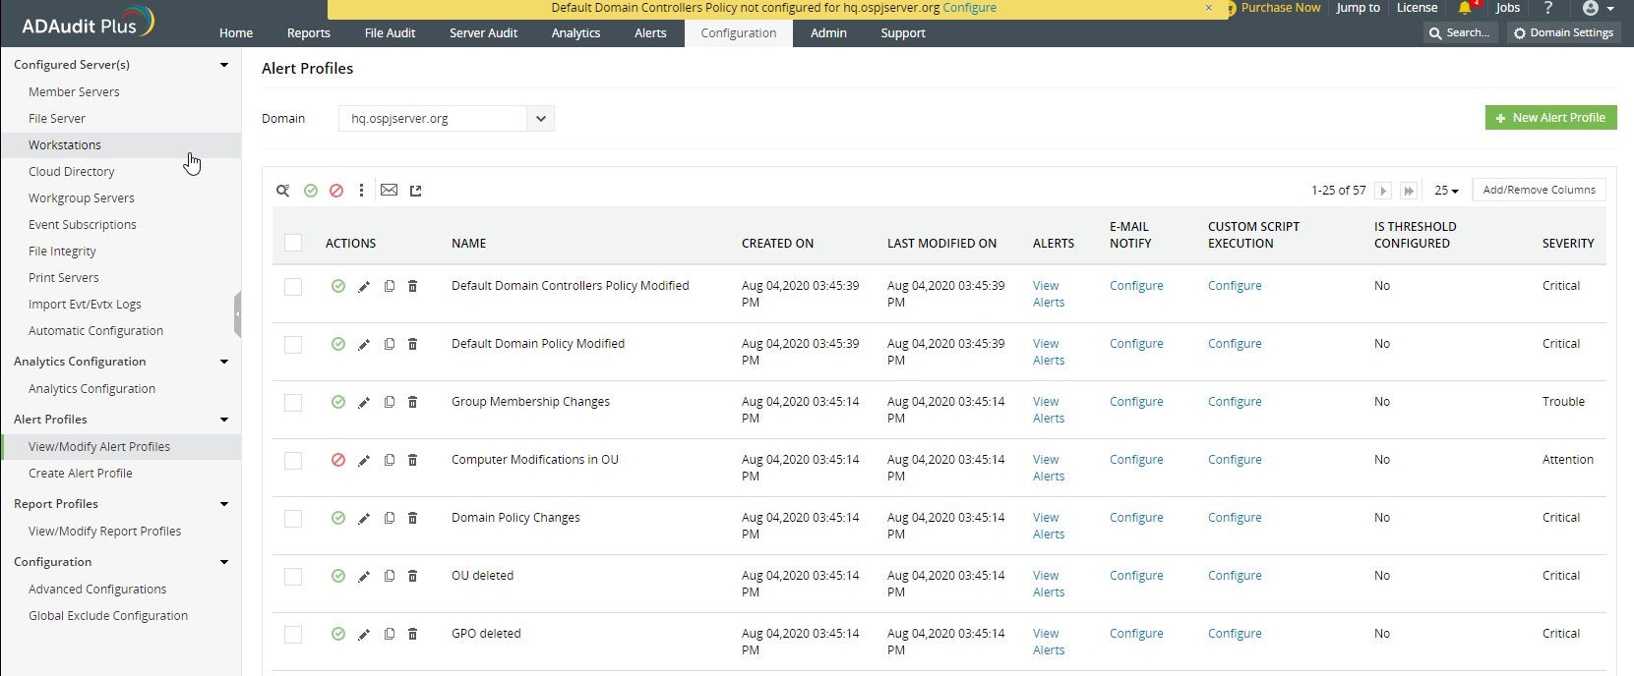
Test Case (1): A person (administrator/authorized/unauthorized) make changes to system configurations

Slide 32
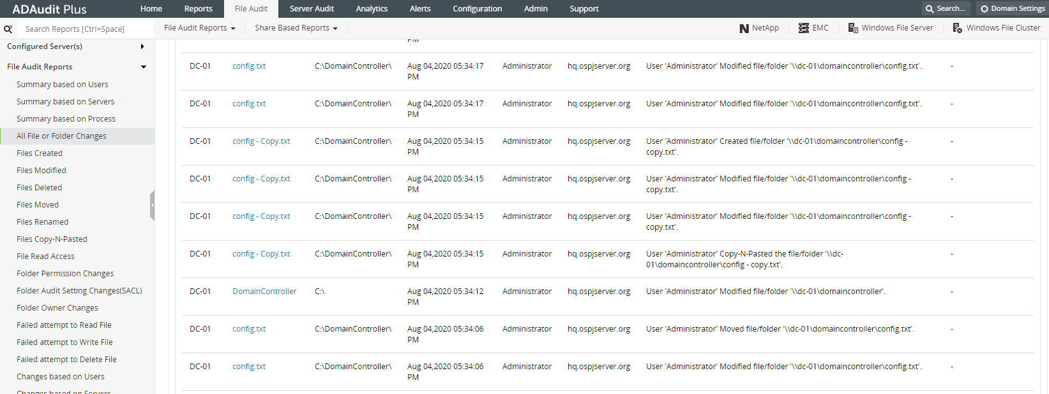
Test Case (2): A person (administrator/authorized/unauthorized) make changes to system file/folder

Slide 33

Q&A

Slide 34


